Slide 1
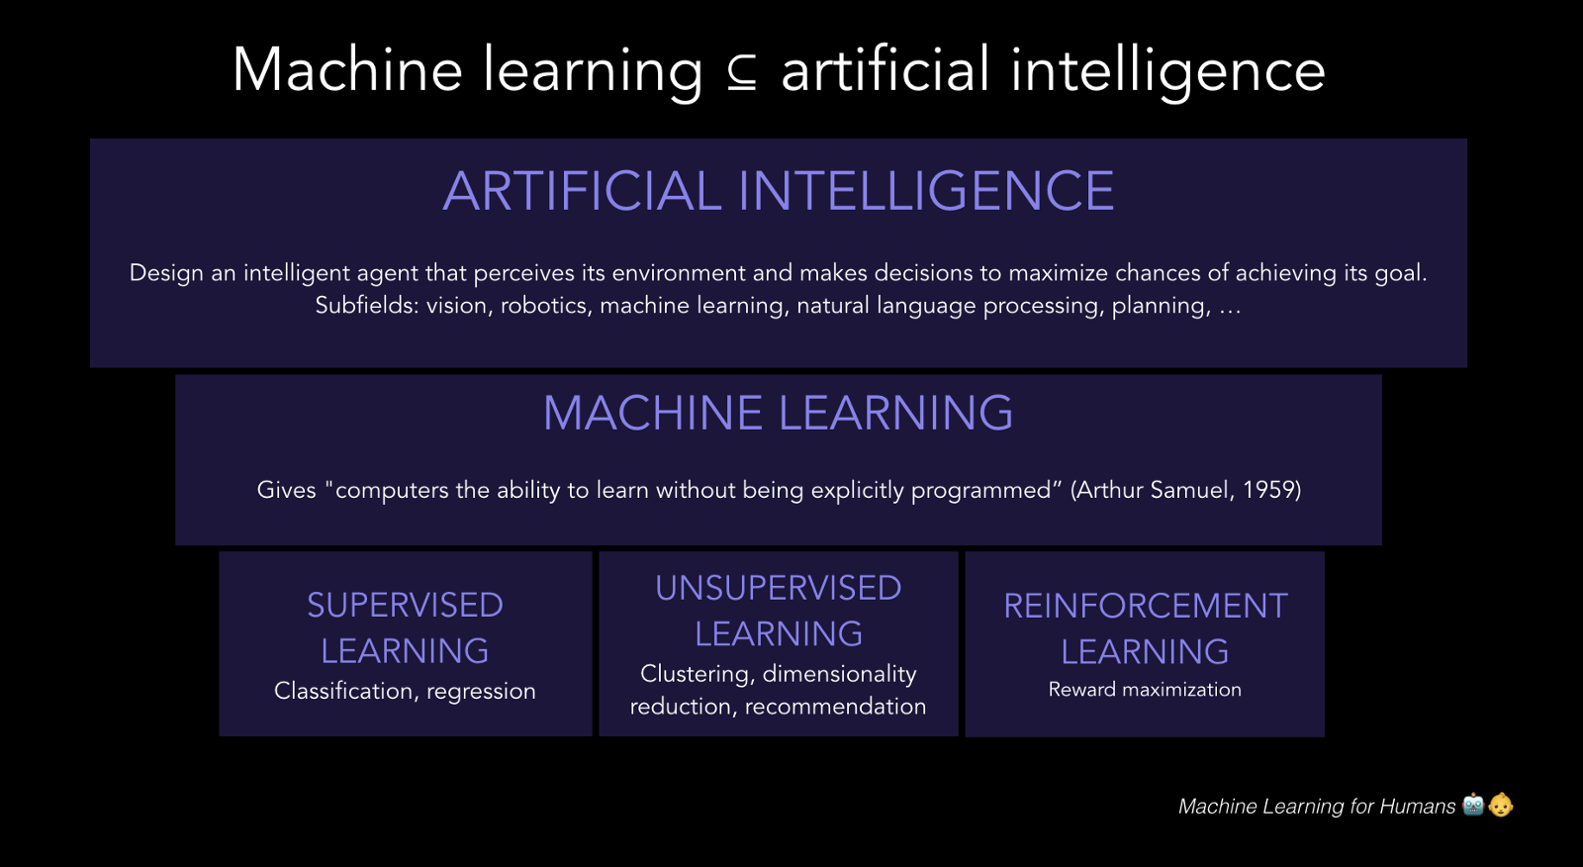
INTRODUCTION

Slide 2
MACHINE LEARNING Machine learning is an application of artificial intelligence (AI) that provides systems the ability to automatically learn and improve from experience without being explicitly programmed.
Simple Data set
Complex Data set
We can easily predict the unknown number inside the bracket
[0,0]
[3,6]
[6,12]
[9,18]
[12,?]
Difficult to predict if each row was composed of large numbers with decimal points running into double digits
[234.567,469.134]
[ 938.268,2814.804]
[5629.608,?]

Slide 3
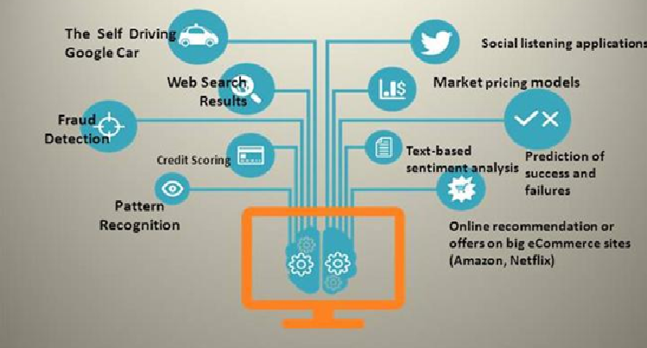
MACHINE LEARNING (Examples)

Slide 4
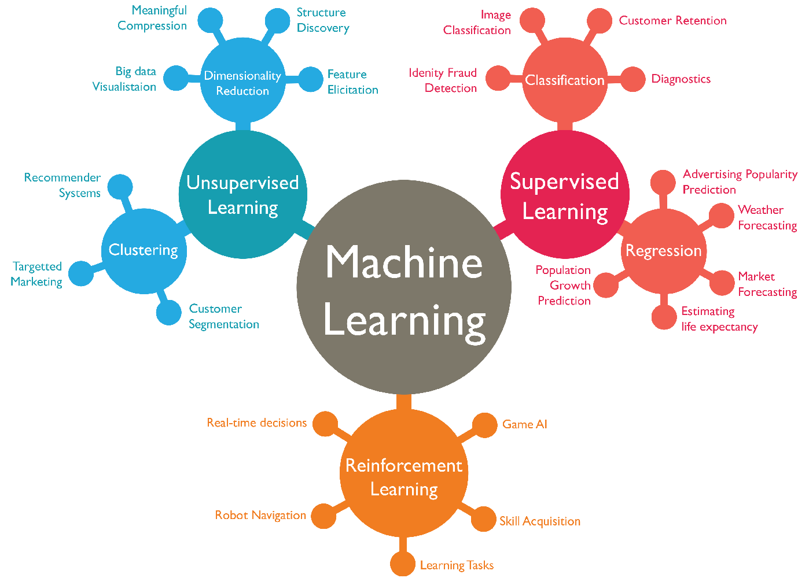
MACHINE LEARNING (Algorithms)

Slide 5
Supervised learning
Supervised learning is where you have input variables (x) and an output variable (Y) and you use an algorithm to learn the mapping function from the input to the output.
Y = f(X)
The goal is to approximate the mapping function so well that when you have new input data (x) that you can predict the output variables (Y) for that data.

Slide 6
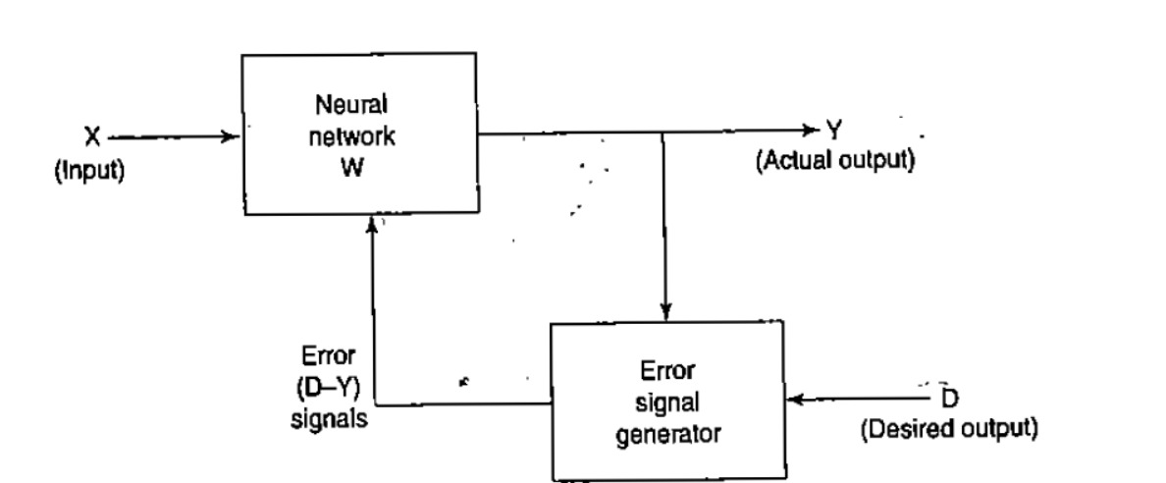
Supervised learning

Slide 7
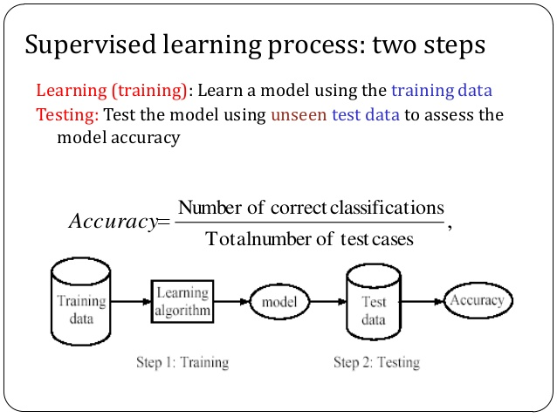
Supervised learning

Slide 8
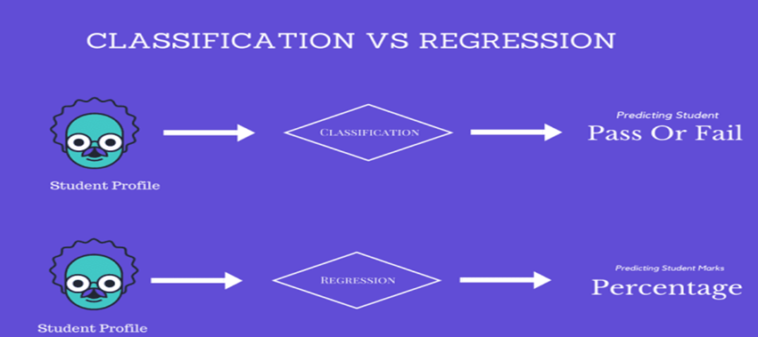
Supervised learning

Slide 9
UNSUPERVISED LEARNING
Unsupervised machine learning algorithms infer patterns from a dataset without reference to known, or labeled, outcomes.
Unlike supervised machine learning, unsupervised machine learning methods cannot be directly applied to a regression or a classification problem because you have no idea what the values for the output data might be, making it impossible for you to train the algorithm the way you normally would.

Slide 10
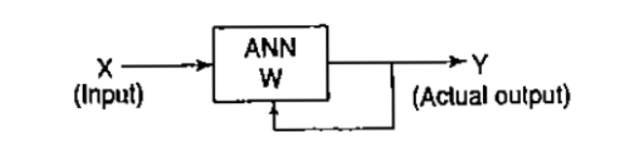
UNSUPERVISED LEARNING

Slide 11
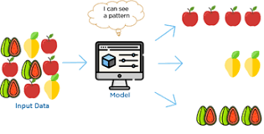
UNSUPERVISED LEARNING TECHNIQUES

Slide 12
UNSUPERVISED LEARNING TECHNIQUES
CLUSTERING
A friend invites you to his party where you meet totally strangers. Now you will classify them using unsupervised learning (no prior knowledge) and this classification can be on the basis of gender, age group, dressing, educational qualification or whatever way you would like. Why this learning is different from Supervised Learning? Since you didn't use any past/prior knowledge about people and classified them "on-the-go".

Slide 13
REINFORCEMENT LEARNING
Reinforcement learning is an area of Machine Learning.
It is about taking suitable action to maximize reward in a particular situation.
It is employed by various software and machines to find the best possible behavior or path it should take in a specific situation.
Reinforcement learning differs from the supervised learning in a way that in supervised learning the training data has the answer key with it so the model is trained with the correct answer itself whereas in reinforcement learning, there is no answer but the reinforcement agent decides what to do to perform the given task. In the absence of training dataset, it is bound to learn from its experience.

Slide 14
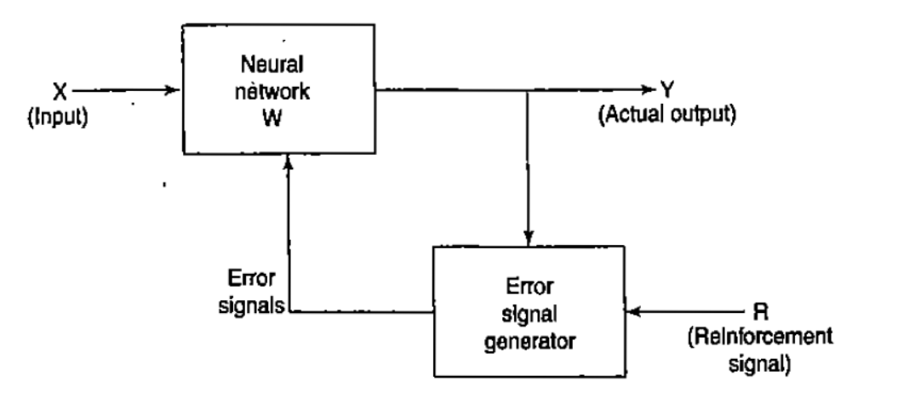
REINFORCEMENT LEARNING

Slide 15
Reinforcement machine learning algorithms is a learning method that interacts with its environment by producing actions and discovers errors or rewards. Trial and error search and delayed reward are the most relevant characteristics of reinforcement learning. This method allows machines and software agents to automatically determine the ideal behavior within a specific context in order to maximize its performance. Simple reward feedback is required for the agent to learn which action is best; this is known as the reinforcement signal.

Slide 16
